Slide 1


PARTS-TO-PURPOSE
Team : Komal, Mary, Nathan, Phillip, Tony
Description:
Parts-to-Purpose is an open-source, inexpensive inventory and people management platform that allows nonprofits to manage their:
Inventory
Donees
Donors

Slide 2




THE USER
A typical DNA extraction experiment requires ~$127 of materials (test tubes, funnels, graduated cylinders, etc.). That’s over a quarter of the yearly science budget for some teachers for a single experiment. Where and how can I find more supplies?
91% of teachers tell us that the biggest challenge to implementing laboratory activities in the classroom is lack of supplies (107 out of 117 Georgia life science teachers surveyed)¹
USER PROBLEM: Where and how can I get more supplies as a science teacher to teach my class?
$1.50 / student
*$450/year
$3.00 / student
*$600/year
Assuming 300 students, ¹ http://www.georgiabioed.org/education/equipment-depot/
Notes:
Imagine that you are a science teacher teaching in a junior high or high school located in rural areas of Georgia. Also, imagine that every year you get at minimum of $1.50 per student to spend on science supplies.
Now imagine that you want to do a DNA extraction experiment. Purchasing the supplies alone can cost you over a quarter of your yearly science budget for one simple experiment. Now imagine that you had planned on 5 science experiments in the year. You’ve blown your budget.
91% of teachers say that their biggest challenge in implementing lab experiments is the lack of supplies. How do you, as a science teacher get access to supplies that you need to teach your class?
Test tube rack = $5.50/rack
Eye Droppers = $10/pk of 110
Funnel = $10/pk of 65
Test Tubes = $27/case of 1000
Graduated cylinder = $10/each
Total cost for 10 stations: ~$127

Slide 3



THE SMALL NON-PROFIT
Georgia BioEd Institute’s Equipment Depot provides grades 6-12 teachers with the laboratory supplies and equipment they need to prepare students for careers in the life sciences.
Supply donations are collected from companies and universities and provided to schools that desperately need it
NON-PROFIT PROBLEM: How can GABioEd manage its inventory of donations when the information is kept in different locations, managed by various volunteers, and not easily accessible by the educators who need them?
Notes:
Now imagine that there is a small non-profit, Georgia BioEd, who has the very solution to the teachers’ problems. Georgia BioEd has an Equipment Depot that houses donations of laboratory supplies from companies and universities and provides grades 6-12 teachers with the supplies and equipment they need to prepare students for careers in the life sciences.
However, because they are a small non-profit working on a shoestring budget, they rely on volunteers (such as myself) and google drive apps to help run their program. They maintain their inventory of laboratory supplies on spreadsheets and send out google drive links to teachers to see what you have to select from in their inventory.
Their biggest problem is how can they manage inventory of donations when the information is kept in different locations, managed by various volunteers, and not easily accessible by the educators who need them?

Slide 4

WHO WE ARE AND WHY WE DID THIS?
Parts-to-Purpose
Who we are - We are a group of IT developers looking to build simple solutions to help small nonprofit organizations
Our Product - Parts-to-Purpose is an inventory management platform that allows nonprofits to track, update, and manage, and donations
Our Goal - To help nonprofits achieve their purpose by connecting the people in need to the “parts” that are offered
Notes:
That’s where we come in. We are a group of IT developers looking to build simple solutions to help small nonprofit organizations. Our app is called Parts-to-Purpose. It is an open-source, inexpensive inventory and people management platform that nonprofits can use to manage their inventory of donations, donors, and donees. Our overall goal is to help nonprofits meet their mission by immediately connecting the “purpose” in need to the “part” that’s needed.

Slide 5
PARTS-TO-PURPOSE: 6 KEY FEATURES
Filters
Users can filter inventory by organization and category
Registration
Collects user contact information
Login
Enables shopping cart, to create order, and arrange pickup
Order Confirmation
Email confirmation sent upon order submission
Automatic Update
Removes requested items from inventory after order
Data Maintenance
Managed with MongoDB
Notes:
That’s where we come in. We are a group of IT developers looking to build simple solutions to help small nonprofit organizations. Our app is called Parts-to-Purpose. It is an open-source, inexpensive inventory and people management platform that nonprofits can use to manage their inventory of donations, donors, and donees. Our overall goal is to help nonprofits meet their mission by immediately connecting the “purpose” in need to the “part” that’s needed.

Slide 6
OUR PROCESS
1
2
3
4
5
6
7
Project Plan Generation
Wireframe Mock-up
User Story Development
Database Modeling
Technology Selection
Coding
Deployment
Created schedule
Used Kanban System
Established deadlines
Created/Assigned Tasks
GoMockingBird
Created 13 User Stories
5 User Stories became MVP
Acquired actual dataset from non-profit partner
Created proof-of-concept for database selection
MDBReact
bcrypt
nodemailer
rc-touchable
Code Reviews
Unit Testing
End-to-End Testing
Continuous Deployment
Deployment to Heroku
Fully functional and responsive MVP
Notes:
We followed a 7-step process from planning to design to implementation.

Slide 7

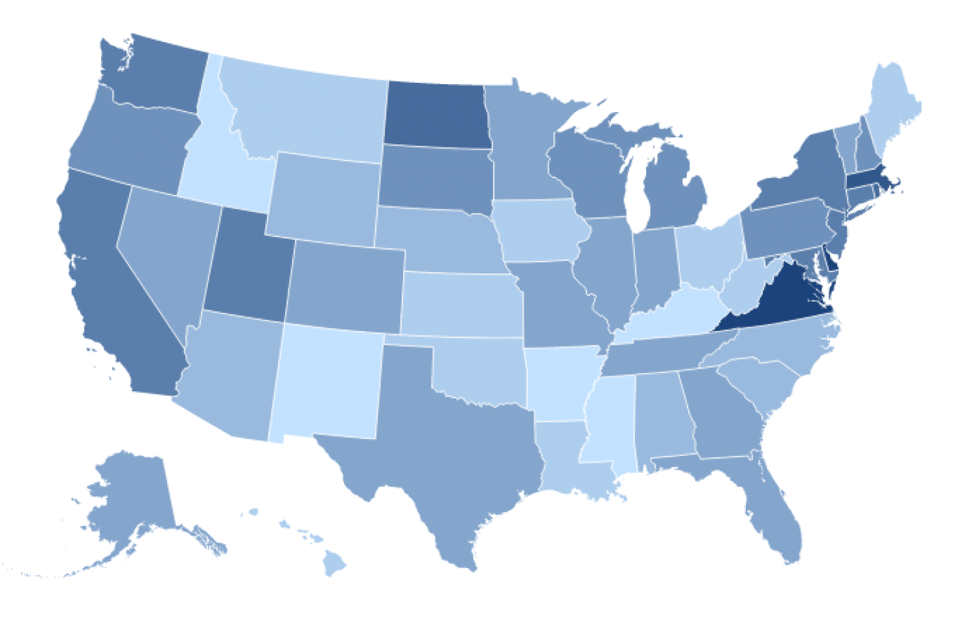



FUTURE FEATURES
Admin Page
Allow organizations to update, manage, and track inventory directly
Search Order History
Give donees a way to review order history
Include Print button on the Order Confirmation page
Analytic Data Tracking
Collect and visualize metrics to identify trends in requested items over time
Allows non-profits to proactively increase inventory, before a need arises
Notes:
Admin Page- Currently there is no admin accounts and if a charity wants to be a parter, they would have to send to us
Search Order History - Useful for collecting data and tracking expindetures. The Print button would be an easy way to store order confirm slips locally for users.
Analytic Data Tracking- Tracking user requests, especially for educators, would give admins a way to warn users if a particular item they have requested is not in stock. Gives charity partners a way to look at most in demand items to request from donators.

Slide 8






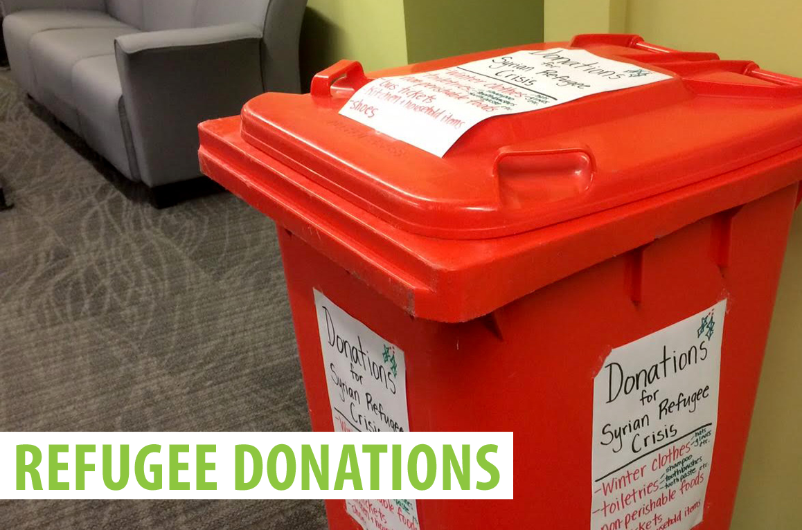
OUR VISION - HELPING OTHERS CONNECT “PARTS TO PURPOSES”
Notes:
Our vision is that in the end, others would be able to re-purpose our application for charities that they’ve created so that we can continue to help others connect ”parts” to their “purpose”

